Slide 1
Development of AI/ML based solution for detection of face-swap based deep fake videos
CSE7101- Capstone Project
Review-3
Batch Number: PSCS_314
NAME | ROLL_NO
S SANDEEP KUMAR | 20221CSG0136
YOGESH | 20221CS0G128
L PRAJWAL | 20221CS0G161
Under the Supervision of,
Mr. Himansu Sekhar Rout
Assistant Professor
School of Computer Science and Engineering
Presidency University
Name of the Program: CSG
Name of the HoD: Dr. Anandaraj S.P
Name of the Program Project Coordinator: Dr. Sharmasth Vali
Name of the School Project Coordinators: Dr. Sampath A K , Dr. Geetha A

Slide 2
DETAILS
Organization: National Technical Research Organisation (NTRO)
Category: Software.
Problem Description:
This project is the development and evaluation of an AI/ML solution to detect face-swap deepfake videos, focusing on a Recurrent Convolutional Strategy.
The core of the project is a hybrid CNN-LSTM model designed to analyze videos for both spatial artifacts (like unnatural textures in a single frame) and temporal inconsistencies (like flawed blinking patterns over time).
The models will be trained and tested on challenging public datasets like FaceForensics++ and Celeb-DF, with the ultimate aim of demonstrating the superior effectiveness of a spatio-temporal model in combating sophisticated digital forgeries.

Slide 3
Problem Statement
The Challenge of Hyper-Realistic Deepfakes
(problem statement number:PSCS_314)
The rapid rise of Generative AI has enabled the creation of hyper-realistic face-swap deepfake videos, blurring the line between authentic and synthetic media.
This technology poses a severe threat to society through political disinformation, financial fraud, and personal defamation.
Existing detection methods often fail to generalize against new forgery techniques and struggle to identify subtle temporal inconsistencies that reveal a video's true nature.

Slide 4
Algorithms
ALGORITHMS USED AND THEIR IMPLEMENTATION:
MTCNN (Multi-task Cascaded Convolutional Networks)
Purpose: Face detection and landmark extraction
How it works:
- Three-stage cascade: P-Net, R-Net, O-Net
- P-Net: Proposal generation for face candidates
- R-Net: Refines proposals and removes false positives
- O-Net: Final detection with 5 facial landmarks
- Outputs: Bounding boxes, confidence scores, 5 key points
Usage: self.detector.detect(pil_frame, landmarks=True)
SIMILARITY TRANSFORMATION (Affine Transformation)
Purpose: Face alignment and normalization
How it works:
- Uses 5 facial landmarks from MTCNN
- Calculates transformation matrix to standard pose
- Applies scaling, rotation, and translation
- Warps face to 224x224 standardized format
Algorithm: cv2.estimateAffinePartial2D() + cv2.warpAffine()
DENSENET-121 (Densely Connected Convolutional Networks)
Purpose: Spatial feature extraction from face images
How it works:
- Pre-trained on ImageNet for transfer learning
- Dense blocks with skip connections
- Feature reuse through concatenation
- Extracts 1024-dimensional feature vectors
- Removes final classification layer for feature extraction
BIDIRECTIONAL GRU (Gated Recurrent Unit)
Purpose: Temporal sequence modeling
How it works:
- Processes 5-frame sequences bidirectionally
- Forward GRU: processes frames 1→5
- Backward GRU: processes frames 5→1
- Combines temporal information from both directions
- Hidden size: 512, Layers: 2, with dropout
- Outputs concatenated forward+backward features (1024-dim)

Slide 5
Algorithms
ADAM OPTIMIZER
Purpose: Gradient-based optimization
How it works:
- Adaptive learning rates for each parameter
- Combines momentum and RMSprop
- Maintains moving averages of gradients and squared gradients
- Learning rate: 1e-3
- Automatic bias correction
GRAD-CAM (Gradient-weighted Class Activation Mapping)
Purpose: Visual explanation of model decisions
How it works:
- Computes gradients of target class w.r.t. feature maps
- Global average pooling of gradients gives importance weights
- Weighted combination of feature maps creates heatmap
- Shows which facial regions influence FAKE classification
- Target layer: Final DenseBlock of DenseNet-121
IMAGENET NORMALIZATION
Purpose: Input preprocessing for pre-trained models
How it works:
- Normalizes pixel values to match ImageNet statistics
- Mean: [0.485, 0.456, 0.406] (RGB channels)
- Std: [0.229, 0.224, 0.225] (RGB channels)
- Formula: (pixel - mean) / std
- Ensures compatibility with pre-trained DenseNet
RANDOM SPLIT ALGORITHM
Purpose: Dataset partitioning for training/validation/testing
How it works:
- Randomly splits the dataset into three subsets
- Train: 60%, Validation: 20%, Test: 20%
- Uses torch.utils.data.random_split()
- Ensures no data leakage between sets

Slide 6
Algorithms
CONFUSION MATRIX CALCULATION
Purpose: Classification performance visualization
How it works:
- 2x2 matrix for binary classification
- True Positives, False Positives, True Negatives, False Negatives
- Visualized as heatmap using seaborn
- Shows model's classification accuracy per class
ROC-AUC CALCULATION
Purpose: Model performance metric
How it works:
- Receiver Operating Characteristic curve analysis
- Area Under Curve measurement
- Evaluates true positive vs false positive rates
- Range: 0.5 (random) to 1.0 (perfect)
- Handles single-class scenarios gracefully

Slide 7
FILES AND THEIR FUNCTIONS:
DATALOADER.PY
Purpose: Data preprocessing and loading pipeline
Functions:
- Video frame extraction from MP4 (MPEG-4 Part 14) files
- Face detection and alignment using MTCNN (Multi-task Cascaded Convolutional Networks)
- Sequence formation for temporal analysis
- Data augmentation and normalization
2. MODEL.PY
Purpose: Neural network architecture definition
Functions:
- Defines hybrid CNN (Convolutional Neural Network) - RNN (Recurrent Neural Network) model structure
- Spatial feature extraction using DenseNet-121
- Temporal sequence modeling using Bidirectional GRU (Gated Recurrent Unit)
- Binary classification head for REAL/FAKE prediction
3. TRAIN.PY
Purpose: Model training and validation
Functions:
- Training loop with backpropagation
- Validation monitoring and early stopping
- Model checkpointing (saves best model)
- Training history logging

Slide 8
FILES AND THEIR FUNCTIONS:
4. EVALUATE.PY
Purpose: Model performance evaluation
Functions:
- Test set evaluation with metrics calculation
- Confusion matrix generation
- ROC-AUC (Receiver Operating Characteristic - Area Under Curve) score computation (when applicable)
- Results visualization and saving
5. EXPLAIN.PY
Purpose: Model explainability and interpretability
Functions:
- Grad-CAM (Gradient-weighted Class Activation Mapping) heatmap generation
- Visual explanation of model decisions
- Attention map overlay on face sequences
- Saves explainability visualizations
6. REQUIREMENTS.TXT
Purpose: Dependency management
Functions:
- Lists all required Python packages
- Specifies version requirements
- Ensures reproducible environment setup

Slide 9
PERFORMANCE CHARACTERISTICS:
COMPUTATIONAL COMPLEXITY:
- MTCNN (Multi-task Cascaded Convolutional Networks): O(n) per frame, where n = image pixels
- DenseNet-121: O(1) per 224x224 image (fixed architecture)
- Bidirectional GRU (Gated Recurrent Unit): O(sequence_length × hidden_size²)
- Overall: O(frames × pixels + sequence_length × features)
MEMORY REQUIREMENTS:
- Input sequences: 5 × 3 × 224 × 224 = ~600KB (Kilobytes) per sample
- DenseNet features: 1024 dimensions per frame
- GRU (Gated Recurrent Unit) hidden states: 512 × 2 (bidirectional) = 1024 dimensions
- Batch processing: Scales linearly with batch size
ACCURACY EXPECTATIONS:
- Limited dataset : 60-80% approximate accuracy
- ROC-AUC (Receiver Operating Characteristic - Area Under Curve): if possible 0.8-0.95 for well-trained models

Slide 10
DATA FLOW PIPELINE WITH ALGORITHMS AND FORMULAS(Step Wise):
1. INPUT STAGE
Algorithm: File I/O Processing
Input: Video files (.mp4, .avi, .mov, .mkv)
Implementation: cv2.VideoCapture(video_path)
Formula: V = {f₁, f₂, ..., fₙ} where V = video, fᵢ = frame i
2. FRAME EXTRACTION STAGE
Algorithm: OpenCV (Open Source Computer Vision Library) Video Decoding
Process: Sequential frame reading with BGR to RGB conversion
Implementation: cv2.cvtColor(frame, cv2.COLOR_BGR2RGB)
Formula: Fᵣgb = ColorTransform(Fbgr) where F = frame matrix
Output: RGB frames of shape (H, W, 3)
3. FACE DETECTION STAGE
Algorithm: MTCNN (Multi-task Cascaded Convolutional Networks)
Sub-algorithms:
- P-Net (Proposal Network): L = L_cls + α₁×L_box + α₂×L_landmark
- R-Net (Refine Network): Refinement with NMS (Non-Maximum Suppression)
- O-Net (Output Network): Final detection + 5 landmarks
Implementation: boxes, probs, landmarks = detector.detect(pil_frame, landmarks=True)
Formula: IoU = Area(B₁ ∩ B₂) / Area(B₁ ∪ B₂) for NMS
Output: Bounding box [x₁, y₁, x₂, y₂], 5 landmarks [(x₁,y₁)...(x₅,y₅)]

Slide 11
DATA FLOW PIPELINE WITH ALGORITHMS AND FORMULAS(Step Wise):
4. FACE ALIGNMENT STAGE
Algorithm: Similarity Transformation (Affine Transformation)
Process: 5-point landmark-based face normalization
Implementation: cv2.estimateAffinePartial2D(landmarks, ref_points)
Transformation Matrix: [s×cos(θ) -s×sin(θ) tx] [s×sin(θ) s×cos(θ) ty]
Formula: P' = T × P where T = transformation matrix, P = original points
Output: Aligned face 224×224 pixels
5. SEQUENCE FORMATION STAGE
Algorithm: Temporal Windowing with Padding
Process: Group consecutive aligned faces into sequences
Implementation: while len(aligned_faces) < sequence_length: pad_sequence()
Formula: S = [F₁, F₂, F₃, F₄, F₅] where S = sequence, Fᵢ = aligned face i
Padding Strategy: Repeat last frame or zero-fill if no faces
Output: Tensor shape (5, 224, 224, 3)
6. PREPROCESSING STAGE
Algorithm: ImageNet Normalization
Process: Standardization for pre-trained model compatibility
Implementation: transforms.Normalize(mean=[0.485, 0.456, 0.406], std=[0.229, 0.224, 0.225])
Formula: X_norm = (X - μ) / σ where μ = channel mean, σ = channel std
RGB Normalization:
- Red: (pixel/255 - 0.485) / 0.229
- Green: (pixel/255 - 0.456) / 0.224
- Blue: (pixel/255 - 0.406) / 0.225
Output: Normalized tensor shape (5, 3, 224, 224)

Slide 12
DATA FLOW PIPELINE WITH ALGORITHMS AND FORMULAS(Step Wise):
7. FEATURE EXTRACTION STAGE
Algorithm: DenseNet-121 (Densely Connected Convolutional Networks)
Process: Spatial feature extraction with dense connectivity
Architecture: Dense blocks with growth rate k=32
Formula: x_l = H_l([x₀, x₁, ..., x_{l-1}]) where [·] = concatenation
Implementation: features = self.feature_extractor(x)
Global Average Pooling: GAP(F) = (1/HW) × Σᵢ Σⱼ F(c,i,j)
Output: Feature vectors shape (5, 1024) per sequence.
8. TEMPORAL MODELING STAGE
Algorithm: Bidirectional GRU (Gated Recurrent Unit)
Process: Sequential processing in both directions
GRU Gates:
- Reset gate: rₜ = σ(Wᵣ × [h_{t-1}, xₜ])
- Update gate: zₜ = σ(Wz × [h_{t-1}, xₜ])
- Candidate: h̃ₜ = tanh(Wₕ × [rₜ ⊙ h_{t-1}, xₜ])
- Hidden state: hₜ = (1-zₜ) ⊙ h_{t-1} + zₜ ⊙ h̃ₜ
Implementation: gru_out, _ = self.gru(features)
Bidirectional: h_final = [h_forward₅, h_backward₁]
Output: Concatenated features shape (1024,)

Slide 13
DATA FLOW PIPELINE WITH ALGORITHMS AND FORMULAS(Step Wise):
9. CLASSIFICATION STAGE
Algorithm: MLP (Multi-Layer Perceptron) with Sigmoid Output
Architecture: Linear(1024→512) → ReLU → Dropout(0.3) → Linear(512→1)
Implementation: logits = self.classifier(final_output)
Activation: σ(x) = 1/(1 + e^(-x)) where x = raw logit
Formula: P(FAKE) = σ(logit), P(REAL) = 1 - P(FAKE)
Output: Single probability score [0,1]
10. TRAINING STAGE (During Training Phase)
Algorithm: Adam (Adaptive Moment Estimation) Optimizer
Loss Function: BCE (Binary Cross-Entropy) with Logits
Loss Formula: L = -[y×log(σ(x)) + (1-y)×log(1-σ(x))]
Adam Updates:
- Momentum: mₜ = β₁×m_{t-1} + (1-β₁)×gₜ
- RMSprop: vₜ = β₂×v_{t-1} + (1-β₂)×gₜ²
- Parameter update: θₜ₊₁ = θₜ - α×m̂ₜ/(√v̂ₜ + ε)
Implementation: optimizer.step() after loss.backward()
Hyperparameters: lr=1e-4, β₁=0.9, β₂=0.999

Slide 14
DATA FLOW PIPELINE WITH ALGORITHMS AND FORMULAS(Step Wise):
11. EVALUATION STAGE (During Testing Phase)
Algorithms: Multiple Evaluation Metric
A) Accuracy Calculation:
Formula: Accuracy = (TP + TN) / (TP + TN + FP + FN)
Implementation: accuracy_score(labels, predictions)
B) ROC-AUC (Receiver Operating Characteristic - Area Under Curve):
Formula: AUC = ∫₀¹ TPR(FPR⁻¹(t)) dt
Where TPR = TP/(TP+FN), FPR = FP/(FP+TN)
Implementation: roc_auc_score(labels, probabilities)
C) Confusion Matrix:
Matrix: [[TN, FP], [FN, TP]]
Implementation: confusion_matrix(y_true, y_pred)
Output: Performance metrics and visualizations
12. EXPLANATION STAGE (For Interpretability)
Algorithm: Grad-CAM (Gradient-weighted Class Activation Mapping)
Process: Generate attention heatmaps for decision explanation
Mathematical Steps:
1. Gradient Computation: ∂y^c/∂A^k_{i,j}
2. Global Average Pooling: α^c_k = (1/Z) × Σᵢ Σⱼ (∂y^c/∂A^k_{i,j})
3. Weighted Combination: L^c_{Grad-CAM} = ReLU(Σₖ α^c_k × A^k)
4. Normalization: CAM_norm = CAM / max(CAM)
Implementation:
- Register hooks: target_layer.register_full_backward_hook()
- Backward pass: target_output.backward()
- Generate heatmap: weighted combination of feature maps
Output: Visual heatmaps showing decision-relevant facial regions

Slide 15
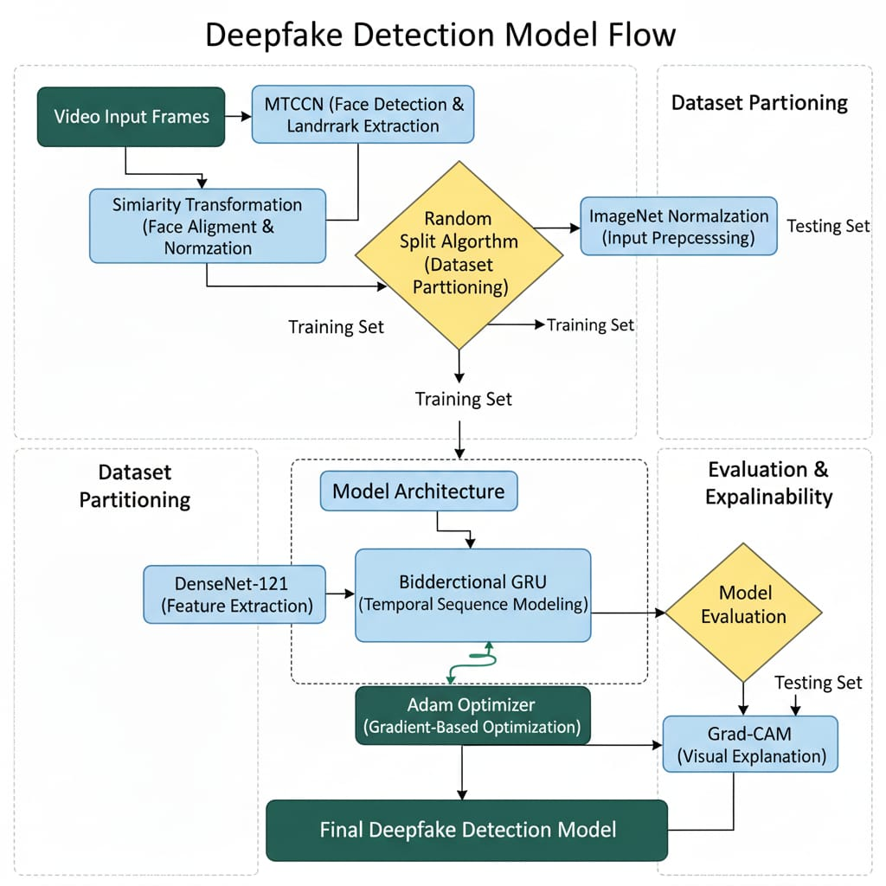
DATA FLOW PIPELINE FLOW CHART:

Slide 16
Github Link
Github Link
https://github.com/SandeepKumar-san/CSG31_PSCS314_DEEPFAKE-DETECTION

Slide 17


